Slide 1





TRAFFIC MANAGEMENT
Name : MOTHILAL NEHRU .S Guide: P.Raja, Master Trainer
NM-ID : aut22lme16
e-mail : motilalnehru03@gmail.com
Reg.no : 811321114311
J.J.COLLEGE OF ENGINEERING AND TECHNOLOGY
Disclaimer: The content is curated for educational purposes only.
Notes:
Slides: Prepare a short slide deck (10-12 slides) summarizing the project objectives, methodology, and key results.

Slide 2

OUTLINE
Abstract of the Project
Problem Statement
Proposed Solution
System Architecture
Live Demo of the Project
Embedded Video of Project
Conclusion
Future Scope

Slide 3


Abstract This project focuses on developing an intelligent traffic management system aimed at improving traffic flow, reducing congestion, and enhancing road safety. Utilizing advanced technologies such as real-time data collection, machine learning algorithms, and smart sensors, the system analyzes traffic patterns and adjusts signal timings dynamically. Key components include traffic monitoring cameras, vehicle detection systems, and a centralized control center that integrates data from various sources. The system also incorporates user feedback through mobile applications, allowing for adaptive responses to changing traffic conditions. The anticipated outcomes include reduced travel times, lower emissions, and improved overall efficiency of urban transportation networks. By leveraging technology, this project aims to create a sustainable solution for modern traffic challenges.

Slide 4

Problem Statement
Traffic Congestion: Urban areas experience significant traffic jams during peak hours, leading to increased travel times and frustration among commuters.
Accidents and Safety Issues: High traffic volumes contribute to a greater likelihood of road accidents, endangering drivers, pedestrians, and cyclists.
Inefficient Signal Timing: Existing traffic signal systems often operate on fixed schedules, failing to adapt to real-time traffic conditions and exacerbating congestion.
Poor Data Utilization: Inadequate collection and analysis of traffic data result in a lack of insights for effective planning and management of traffic flow.
Environmental Impact: Increased vehicle idling and congestion lead to higher emissions, contributing to air pollution and environmental degradation.

Slide 5
Proposed Solution
Intelligent Traffic Signal Systems: Implement adaptive traffic signal control that adjusts timings based on real-time traffic conditions to optimize flow.
Real-Time Traffic Monitoring: Utilize cameras and sensors to collect data on traffic volume, speed, and congestion, providing insights for immediate response.
Traffic Prediction Algorithms: Employ machine learning algorithms to predict traffic patterns and anticipate congestion, enabling proactive management strategies.
Integrated Public Transportation: Enhance coordination between various modes of public transport (buses, trains, etc.) for seamless transitions and reduced reliance on personal vehicles.
Dynamic Routing Applications: Develop mobile apps that provide real-time traffic updates, alternative routes, and estimated travel times to inform drivers.
Smart Parking Solutions: Implement systems that guide drivers to available parking spots, reducing time spent searching for parking and alleviating street congestion.

Slide 6
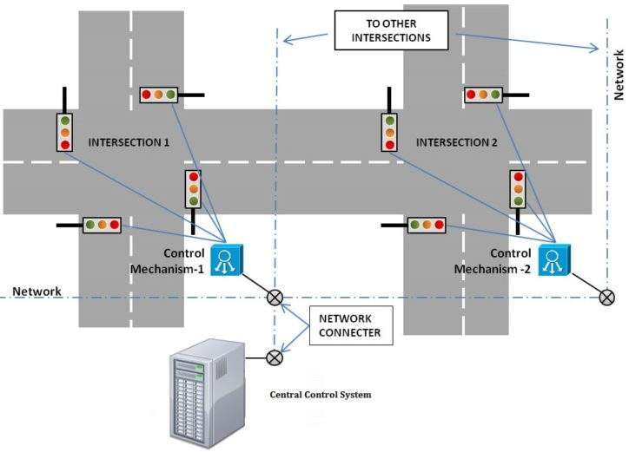
System Architecture

Slide 7
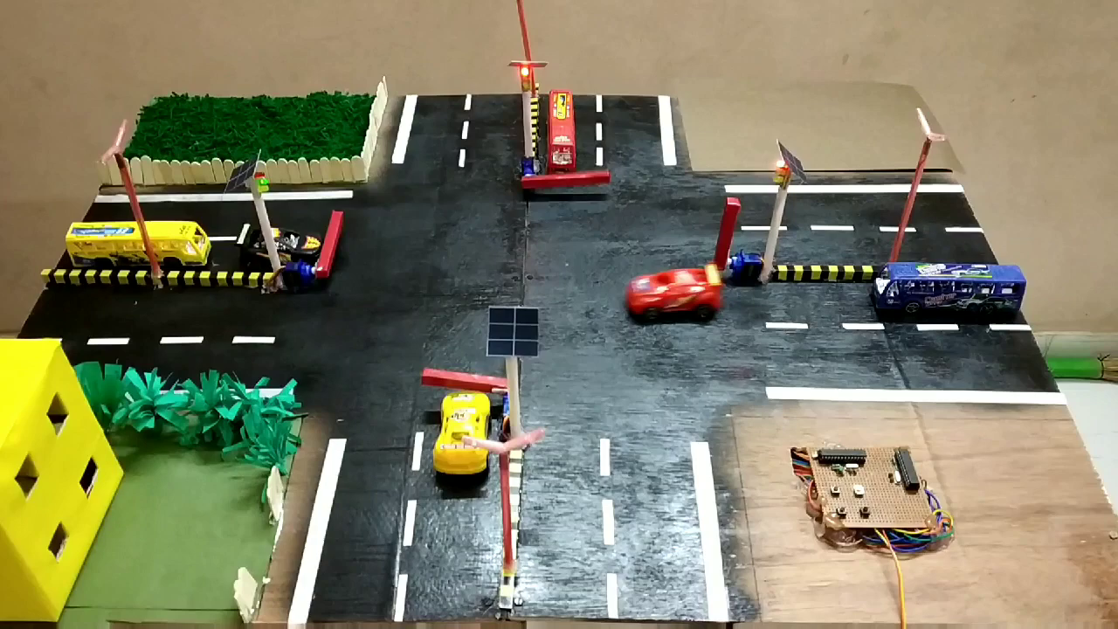
Live Demo of Project

Slide 8
Conclusion
In conclusion, effective traffic management is essential for creating safer, more efficient, and sustainable urban environments. By leveraging advanced technologies such as IoT, artificial intelligence, and real-time data analytics, modern traffic management systems can significantly improve traffic flow, reduce congestion, and enhance road safety. The integration of vehicle-to-infrastructure communication and predictive analytics allows for timely responses to traffic incidents and dynamic adjustments to traffic signals, resulting in smoother commutes and lower environmental impact. However, challenges such as high implementation costs, privacy concerns, and the need for interoperability among various technologies must be addressed to fully realize the potential of these systems. As we move forward, ongoing innovations and future developments in traffic management will be crucial in adapting to changing urban landscapes and transportation needs. By prioritizing collaboration among stakeholders, investing in sustainable practices, and embracing emerging technologies, cities can build resilient traffic management systems that enhance the quality of life for residents while promoting economic growth and environmental stewardship.

Slide 9
Future Scope
Future work in traffic management aims to enhance system efficiency, adaptability, and sustainability by leveraging emerging technologies and innovative approaches. A significant area for advancement is the integration of artificial intelligence (AI) and machine learning to improve predictive analytics for traffic patterns, incident detection, and congestion forecasting. These AI models can become more accurate by using real-time data and constantly learning from changing patterns, which would allow traffic management systems to make faster, more precise decisions.
Another promising area involves vehicle-to-everything (V2X) communication, enabling direct communication between vehicles, infrastructure, and other traffic components. This would allow for cooperative traffic systems where vehicles can share their locations and destinations to improve route planning, minimize congestion, and even facilitate autonomous vehicle operation in urban areas. The development of 5G networks further supports V2X technology by providing the high-speed, low-latency connectivity needed for such interactions, which will make the system faster and more reliable.

Slide 10
Thank you!
Notes:
thank you very much for joining this PPT, keep learning.

